Slide 1

Boundless Analytics Test
Ryan Coslove rmc326

Slide 2
Modification of Snippet 20.1
We were informed to Chi-square hunt code using snippet 20.1 of the online textbook
Using the slices provided on the boundless analytics link we were provided, I looked for the greatest overall disparities between the red bars and the blue bars

Slide 3
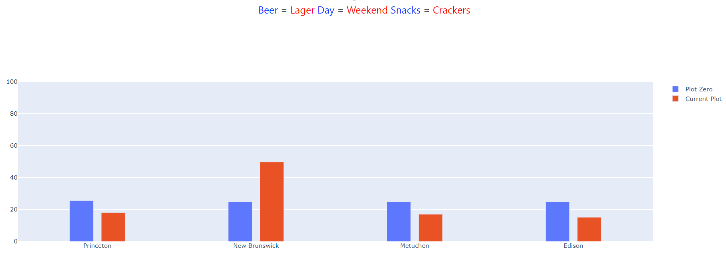
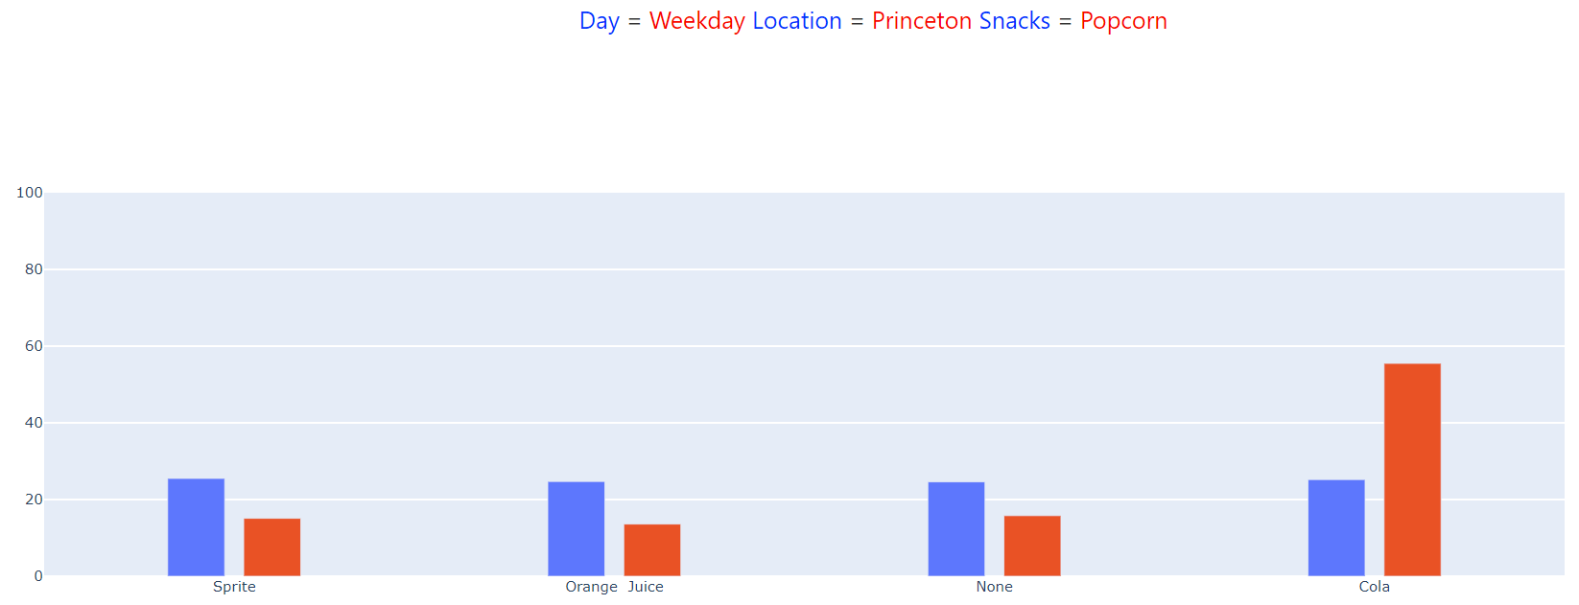
Slices I Tested and Found Interesting
In Location
Beer = Lager
Day = Weekend
Snacks = Crackers
X-squared = 157.51, df = 3, p-value < 2.2e-16
In SoftDrinks
Day = Weekday Location = Princeton Snacks = Popcorn
X-squared = 205.31, df = 3, p-value < 2.2e-16

Slide 4

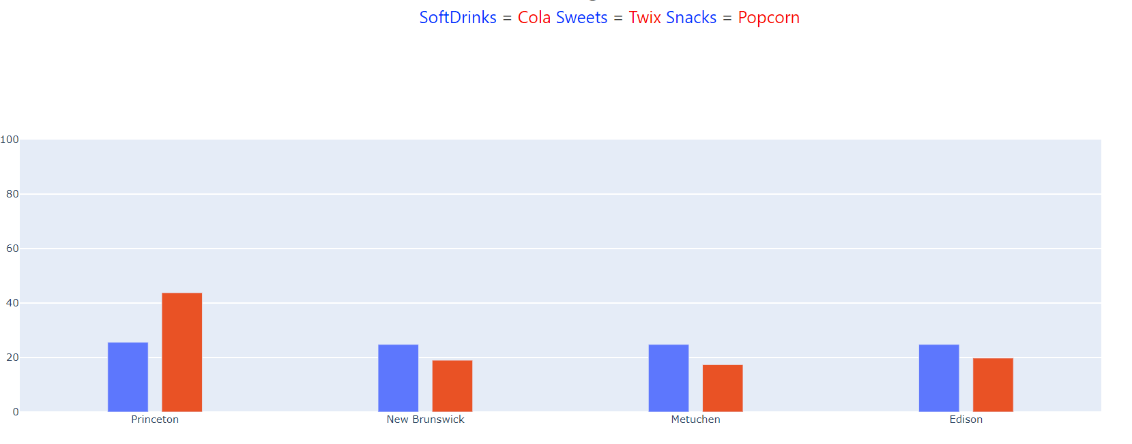
Slices I Tested and Found Interesting
In SoftDrinks
Beer = Lager
Location = Princeton Snacks = Popcorn
X-squared = 79.81, df = 3, p-value < 2.2e-16
In Location SoftDrinks = Cola, Sweets = Twix, Snacks = Popcorn
X-squared = 43.048, df = 3, p-value = 2.404e-09

Slide 5
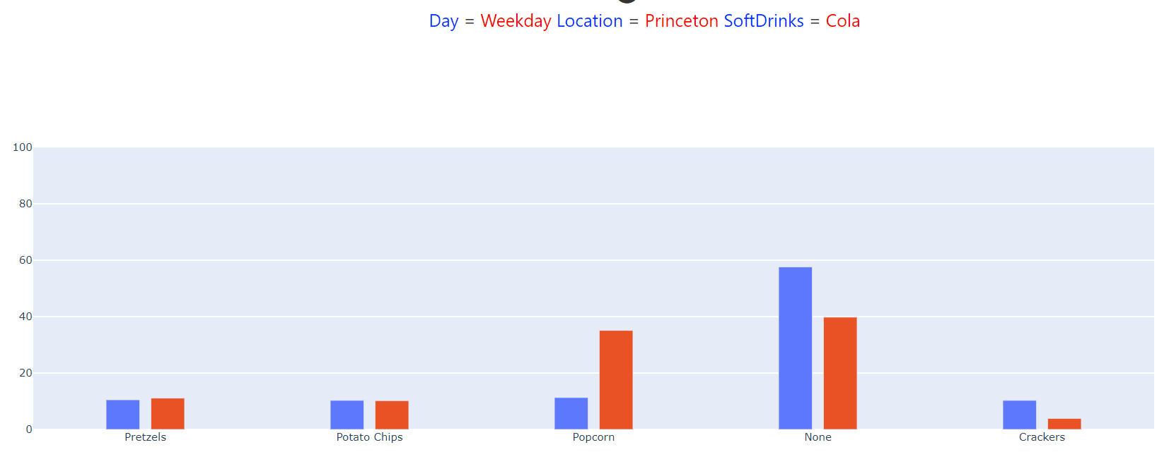
My Best Slice
In Snacks
Day – Weekday
Location – Princeton
SoftDrinks – Cola
Chi-Square was X-squared = 400.8, df = 4,
p-value < 2.2e-16

Slide 6
Conclusions
The share link would not appear for me on the boundary analytics test website, so in the google form I simply submitted the details of my slice which was mentioned in the last slide

